Slide 1
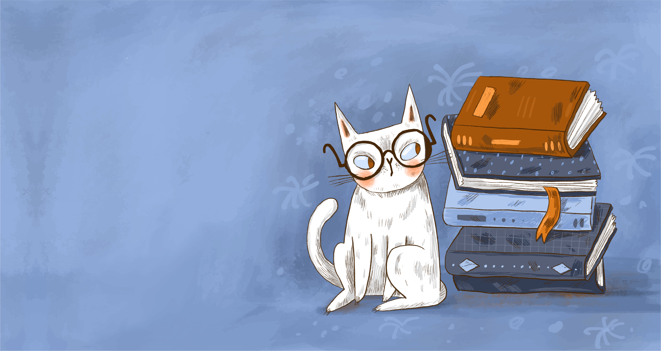
Books
From
Goodreads
Presenter：Jiaxing Li

Slide 2

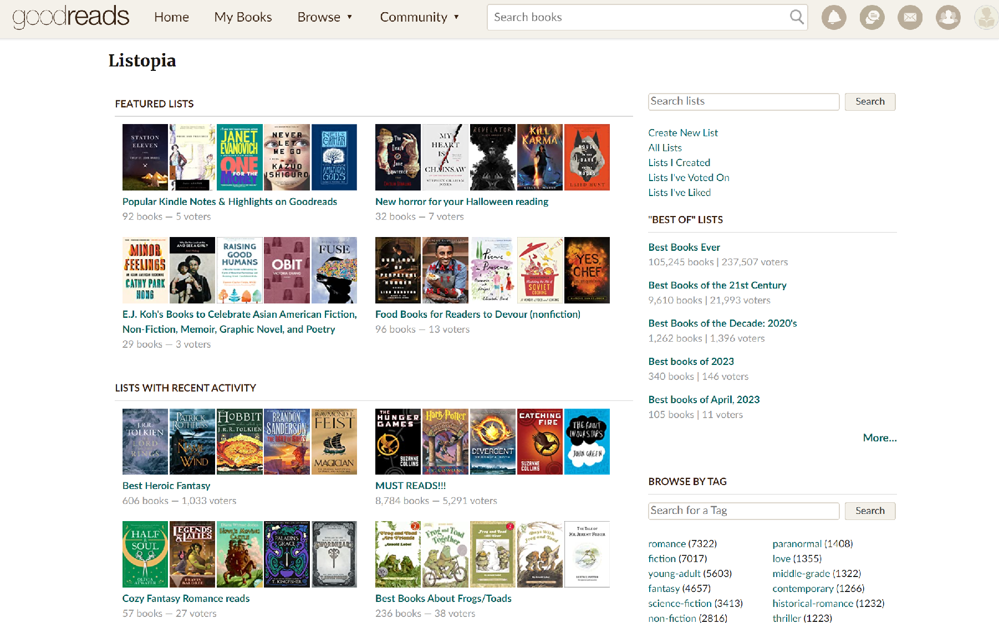
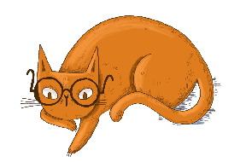
01
Largest English website
90 million members
Rating system

Slide 3
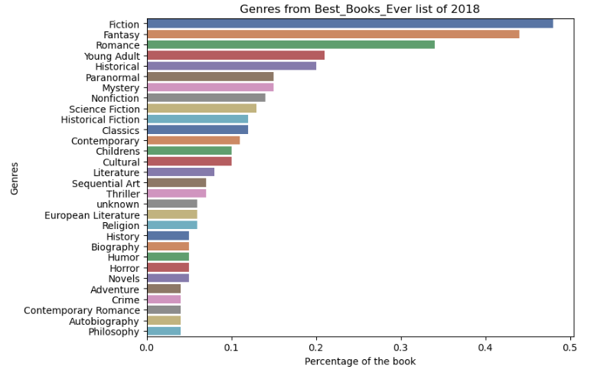
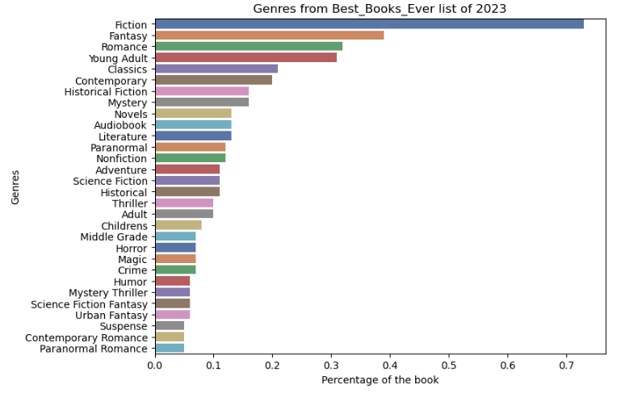

* Fiction : Fiction is the telling of stories which are not real, is an imaginative form of narrative, one of the four basic rhetorical modes.
* Romance: Two basic elements comprise romance novel: a central love story and an emotionally-satisfying and optimistic ending.
* Young Adult: It’s fiction written for, published for, or marketed to adolescents and young adults, roughly ages 13 to 18.
* Historical: History books make up an important genre in non-fiction. They help us understand the past so we can build a better future.

Slide 4
48%
73%
* Fiction : Fiction is the telling of stories which are not real, is an imaginative form of narrative, one of the four basic rhetorical modes.
* Romance: Two basic elements comprise romance novel: a central love story and an emotionally-satisfying and optimistic ending.
* Young Adult: It’s fiction written for, published for, or marketed to adolescents and young adults, roughly ages 13 to 18.
* Historical: History books make up an important genre in non-fiction. They help us understand the past so we can build a better future.

Slide 5
* Fiction : Fiction is the telling of stories which are not real, is an imaginative form of narrative, one of the four basic rhetorical modes.
* Romance: Two basic elements comprise romance novel: a central love story and an emotionally-satisfying and optimistic ending.
* Young Adult: It’s fiction written for, published for, or marketed to adolescents and young adults, roughly ages 13 to 18.
* Historical: History books make up an important genre in non-fiction. They help us understand the past so we can build a better future.

Slide 6
21%
31%
* Fiction : Fiction is the telling of stories which are not real, is an imaginative form of narrative, one of the four basic rhetorical modes.
* Romance: Two basic elements comprise romance novel: a central love story and an emotionally-satisfying and optimistic ending.
* Young Adult: It’s fiction written for, published for, or marketed to adolescents and young adults, roughly ages 13 to 18.
* Historical: History books make up an important genre in non-fiction. They help us understand the past so we can build a better future.

Slide 7


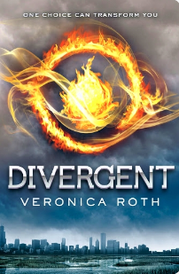
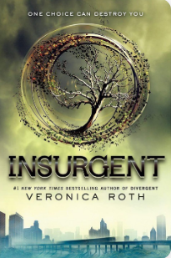
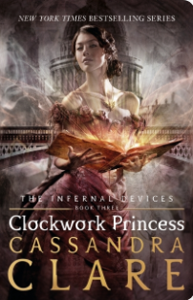
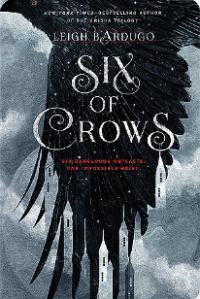
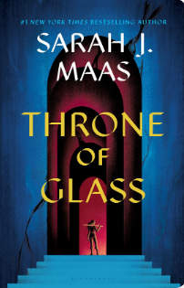
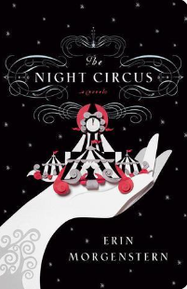
TOP 200
Young Adult
Published after 2010
Fantasy
Rating number over 800.000
Fiction

Slide 8
* Fiction : Fiction is the telling of stories which are not real, is an imaginative form of narrative, one of the four basic rhetorical modes.
* Romance: Two basic elements comprise romance novel: a central love story and an emotionally-satisfying and optimistic ending.
* Young Adult: It’s fiction written for, published for, or marketed to adolescents and young adults, roughly ages 13 to 18.
* Historical: History books make up an important genre in non-fiction. They help us understand the past so we can build a better future.

Slide 9

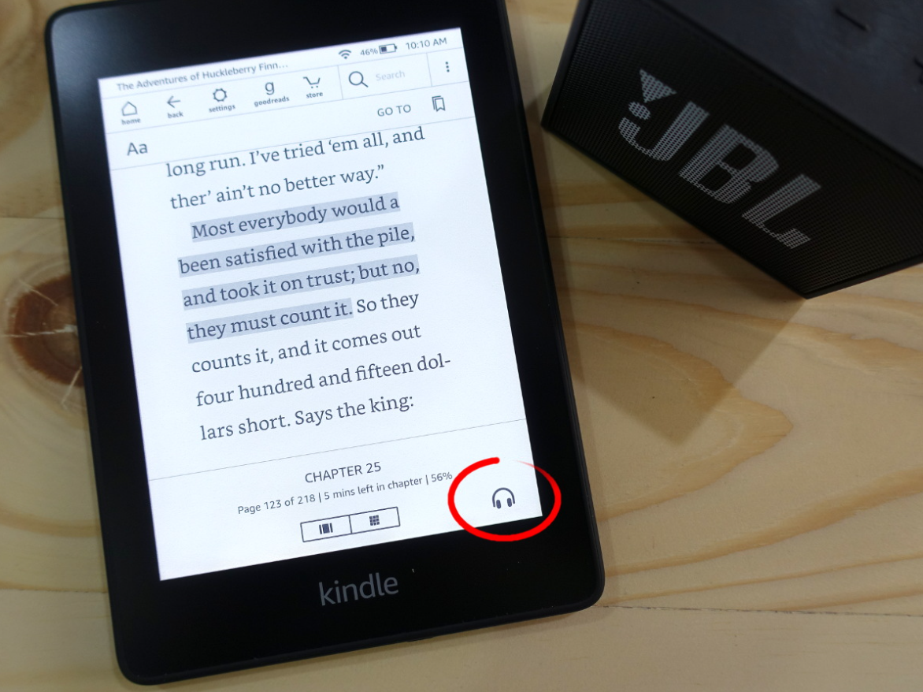
Listen to the book
Listening to audiobooks can be a very immersive experience. You'll find emotions becoming more vivid, actions more striking. And for humorous books, the voice can propel the punch lines even further.
Benefit: Audiobooks can let the eyes rest for a bit, knowing that the Kindle can continue without skipping a beat.

Slide 10
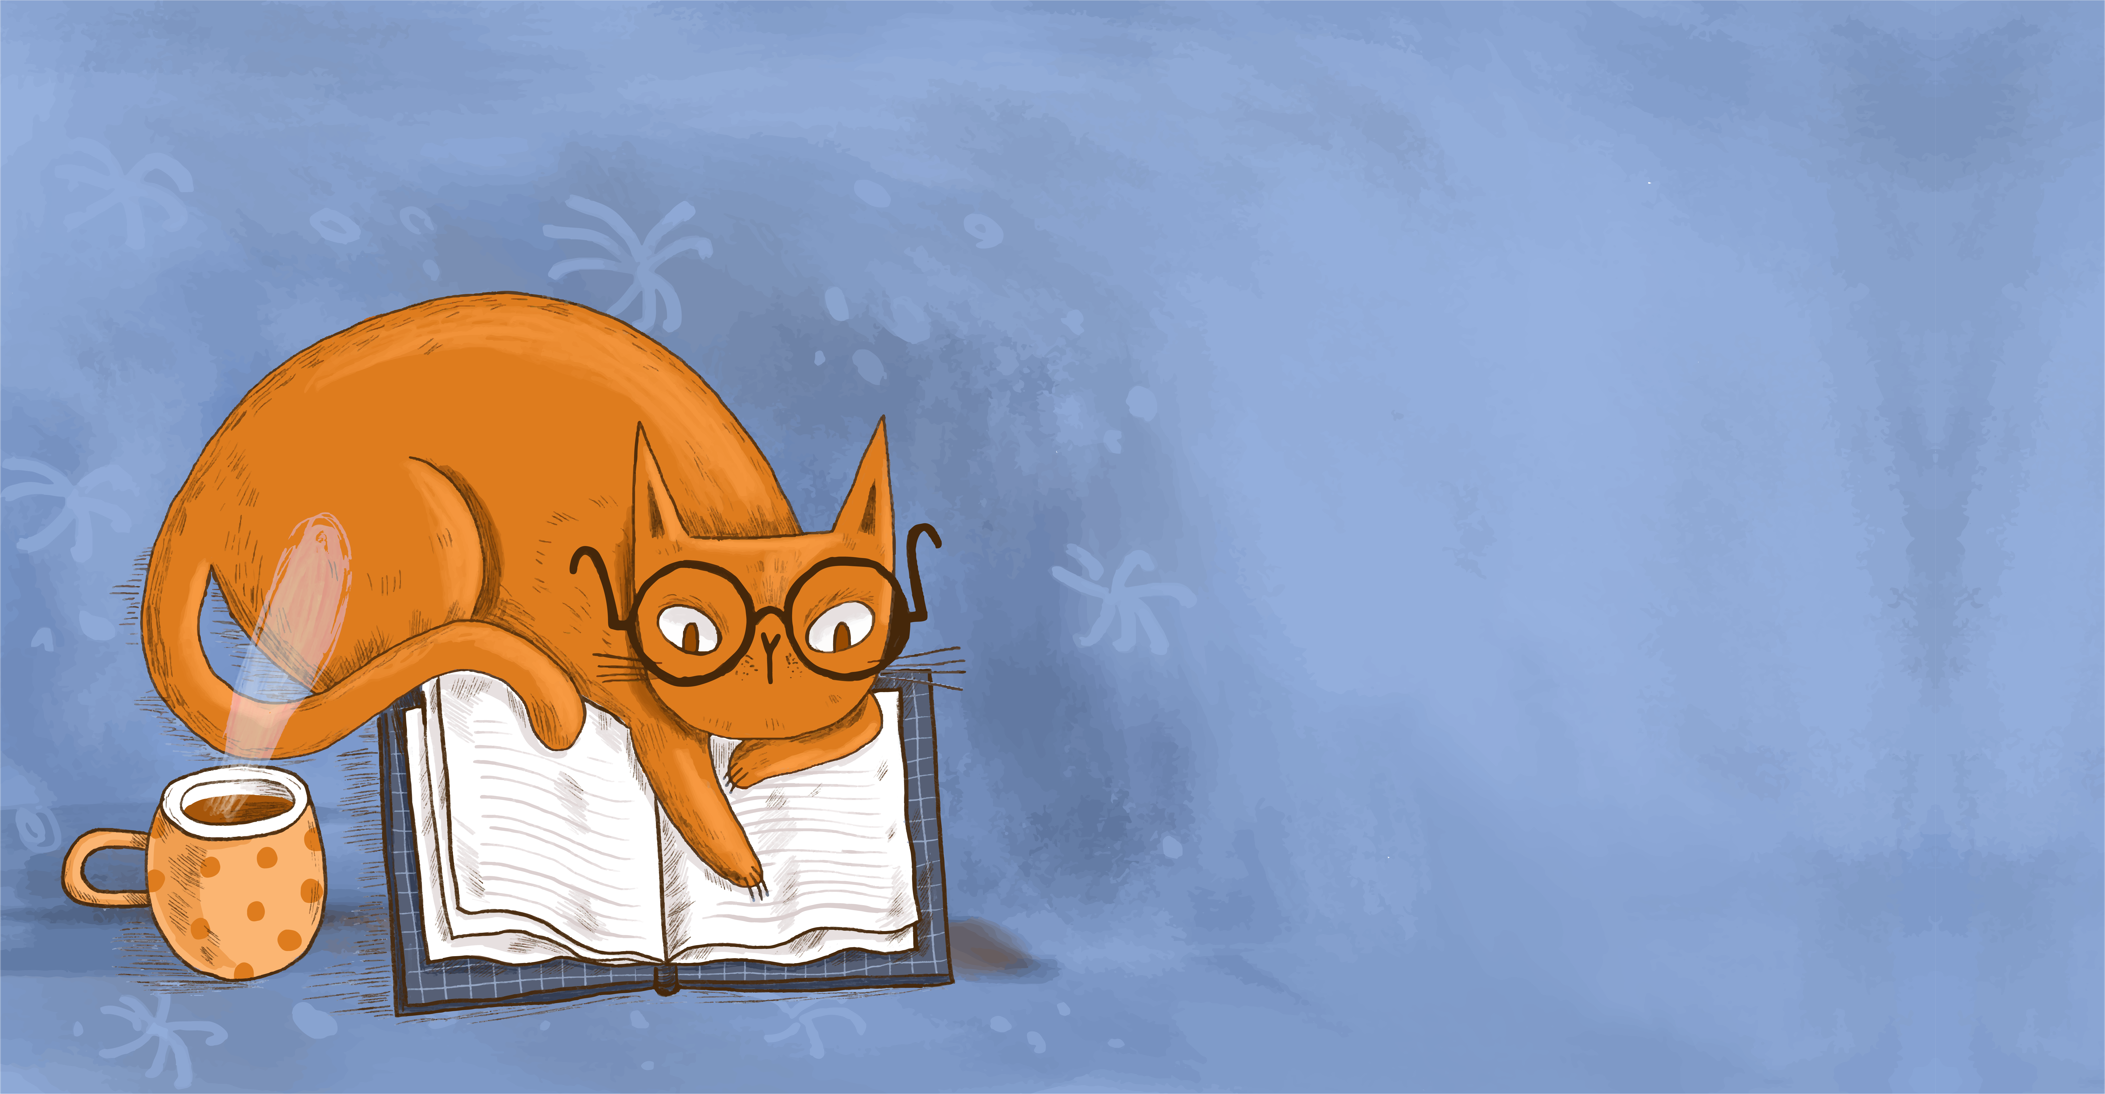
Improve
01
Segmentation of users
02
More ways to make money
03
Exact advertising place
04
Attract normal people
to write books

Slide 11
Thank you !

